Slide 1

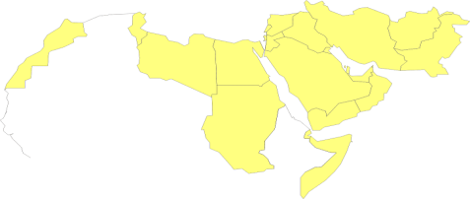
Institution of HTA Programmes in
MENA Countries
Adham R Ismail, MSc, MBA, PhD
Team Leader, Essential Medicines and Technologies Team (EMT)
Regional Adviser, Health Technology and Biomedical Devices (HMD)
Department of Health Systems Development (HSD)
Eastern Mediterranean Regional office (EMRO)
World Health Organization (WHO)
Cairo, 2015

Slide 2
HT in Contemporary Health Systems
They form the foundation for prevention, diagnosis and treatment of illness and disease.
Thousands of new technologies are introduced into practice each year.
Technologies and Health Systems are interdependent: Sustainable supply of technologies require functional health systems and vice-versa.

Slide 4
Waste of scarce resources: ROI on ME
Prior to use
After use
Source: Swiss Center for International Health, Basel, 2005
Notes:
MD are part of HS resources …….
The Swiss centre for international health … value of the original investment in medical equipment depreciate for many reasons.
……
Finally, you will end up having a 10% “Return on Investment”, which is too low.

Slide 5
Medicines, Vaccines & other Health Technologies consume approximately 20-60%* of health budget in LMICs.
Well over
50% of expenditure on Medicines, Vaccines & other Health Technologies is wasted due to one reason or the other.
* Source: Regulatory System Strengthening, WHA Documents, EB134/29, January 2014.

Slide 6
Current Operating Context:
The need to Manage HT
In a supply-driven market, suppliers can be expected to target the region
It will be difficult to contain the burgeoning costs without proper management of demand, through:
  Strengthening NRAs
  Establishment of HTA to support decision making
  Proper HT Management plans (from needs assessment to waste disposal)

Slide 7
Why HTA is important to efficient HS?
How many times countries had to decide whether or not to:
  Buy a new medicine/device?
  Include a clinical service into your benefit package …(UHC)?
  Roll-out or introduce a public health programme?
  Set priorities on healthcare expenditure or service delivery?
  Select the health interventions that produce the greatest health gain and offer value for money from several ones?
  Set prices for medicines, devices and other technologies?
  Decide on procurement of expensive high-tech devices?
Without having a tool to help them make rational decisions on their investments on HT, it will be difficult to achieve SDGs.
This tool is simply called HTA.

Slide 8
Typical Consumer Buying Process
Innovation
R&D
Marketing Authorization
Problem Recognition
Information Search
Evaluation of Alternatives
Purchase Decision
Purchase Process
Post-Purchase Evaluation
Product yet to be placed on the Market
Regulation
PH Needs
Product is on the Market
HTA
(Market Scan)
HTA
(Appraisal)
HTM (Planning)
HTM
(Process)
Innovation, HTR, HTA & HTM

Slide 9

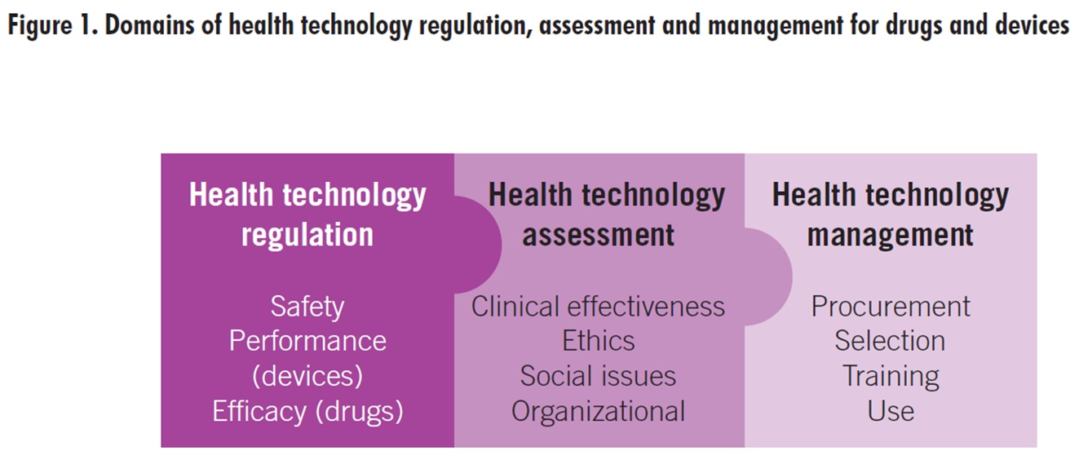
HT Policies
Health technology
Innovation
Medical Processes (R&D)
Business Processes (Marketing, Financing, IT &/or Operating)
Valley of Death

Slide 10
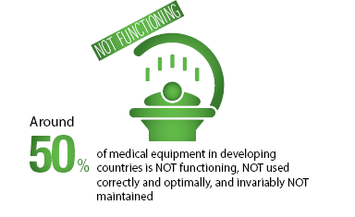
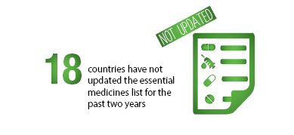
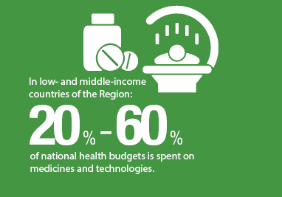
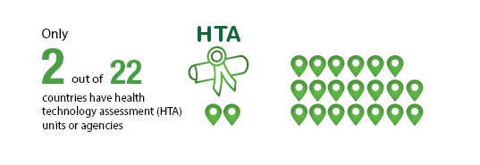
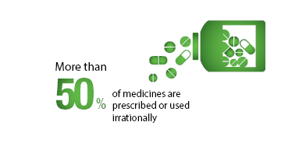
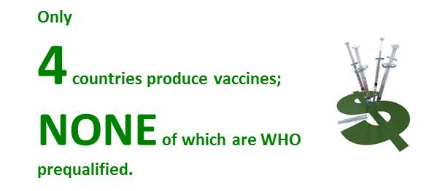
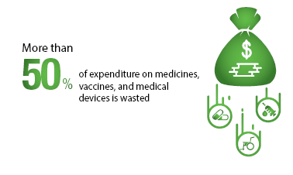
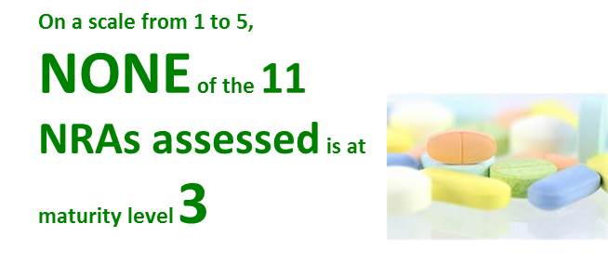
Regional Situation

Slide 11
Number of HTA Agencies in HIC of WHO
SEARO & AFRO: N/A

Slide 12
Number of HTA Agencies in MIC of WHO

Slide 13
How to Develop HTA Programmes?
The Building Blocks
HTA Reports
(Knowledge Generation & Transfer)
Working Processes (From Proposal to Finished Product)
Design & Structure
Attitudes & Values
Operating Context
Governance
Political Will
Financial & Human Resources

Slide 14
The Foundation: Results of Regional Surveys
A comparative study by EUnetHTA in 2008 on HTA agencies in 27 countries (21 from EU) revealed:
  Main initiative for establishing HTA agencies was governmental (61%)
  Main barriers for establishing HTA agencies was in gathering trained staff (64%), funding (45%) and political will (36%).
  MENA countries have to overcome these barriers as a prerequisite to establish effective HTA programmes.
A mapping survey conducted by WHO/EMRO in 2014 revealed that:
  52% perform HTA or HTA-like activities
    Most activities related to clinical effectiveness & economic evaluations (67% & 62% respectively);
    Performed on devices and medicines (79% and 68% respectively).
    Reports were on healthcare costs and selection of appropriate HT (60% and 50% respectively)
  Remaining 48% (not performing HTA-like activities)
    Over 50% don’t know of future plans to develop HTA programmes in their national entities.
    Almost 75% indicated that using HTA in the decision-making process will be their biggest obstacle.

Slide 15
The Foundation: National Situation Analysis
A national survey to investigate the following is required before initiating any HTA programme:
Need for HTA in the country (current HTA and how HTA can help)
Demand for HTA and potential users
Supply of HTA in terms of responsible unit, local data, supporting institutions or agencies, existing infrastructure & training needs.
Source: Situation Analysis of HTA Introduction at National Level, NICE & HiTAP, 2013

Slide 16
Pillar #1: Governance of HTA programs
Local legal framework and feasibility
Relationships with ministry (laws, decrees, SOPs)
Stated objectives (UHC, CPG, formularies, etc.)
Exact role (advisory vs. compulsory, number of assessment stages, involvement of universities and research centers, etc.)
Initial and running costs
Financing options (evaluated against the criteria of HTA programme independence, flexibility, continuity, stability and sustainability)
Evidence collection and synthesis techniques
Knowledge sharing and communication strategies (i.e. transparency)
Accountability (how government should use HTA reports).
Scope of HTA work (topic selection → public communication)
Capacity building
Notes:
Important decisions on health care affecting patient health are to be made on the best scientific basis available.
Vision: Independent assessment for improved health
SBU is to be one of the world's leading institutions for the systematic assessment of methods promoting health and combating illness.
The general aims of SBU:
The SBU knowledge base should mean improved health per Swedish krona invested and thereby save lives and improve quality of life, as well as make possible a good standard of health care provided on equal terms to all.

Slide 17
Pillar #2: Initial Setup (1)
HTA
System
>9 persons
HTA
Committee
4-5 persons
Dedicated
Resources
1-2 persons
HTA Knowledge Mobilizer
Putting HTA into Context
HTA Unit/ Agency

Slide 18
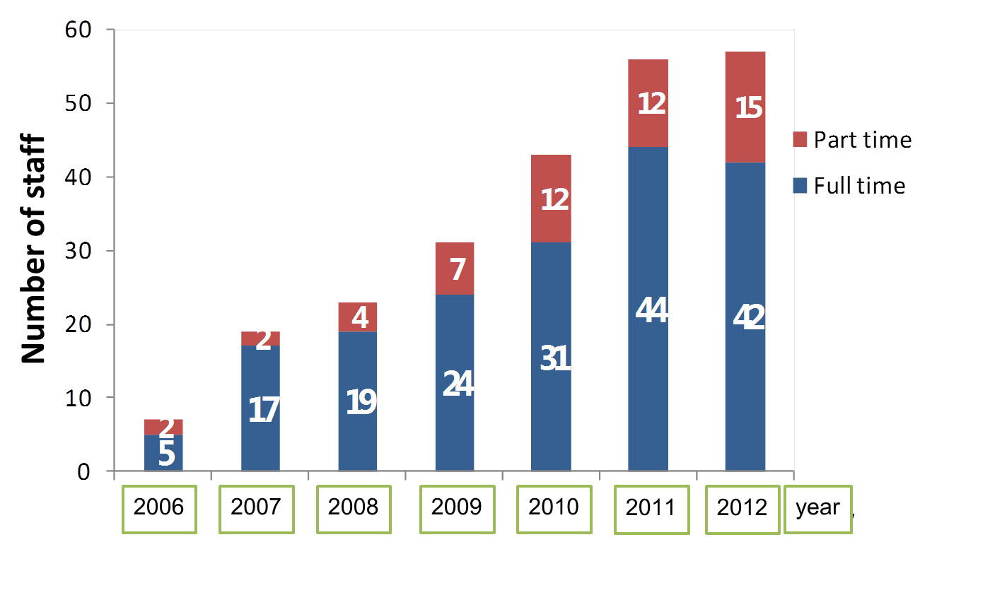
Pillar #2: Initial Setup (2)
Initiation of HiTAP in Thailand
V. Implementing HTA
Source: HiTAP, 2013

Slide 19
Pillar #2: Team Development
Starting with a small and committed group of researchers
  Not everyone needs to be well qualified in HTA or economics
Establish a multidisciplinary team
  Different backgrounds (clinicians, pharmacists, biomedical engineers, epidemiologists, statisticians, etc.).
  Roles and responsibilities includes:
    Active engagement with all key stakeholders groups.
    Revision of evidence related to selected technologies.
    Conduction of assessment studies and surveys (if needed).
    Consultations with external experts (if needed)
    Communication of findings appropriately to decision makers

Slide 20
Pillar #2: Relationship with other entities
(National-based HTA)
Regulatory Approval (NRA)
Market Entry
MOH P&R Decision
Physician Usage
HTA Agency Re-Evaluation
Regulation Chamber Pricing Review
HTA Agency Evaluation
Indirectly Influenced by HTA reports
Foreign HTA reports on effectiveness
No HTA Influence
Limited HTA Influence
Key HTA Step
Based on HTA reports
Key HTA Step

Slide 21
Pillar #2: Relationship with other entities
(Hospital-based HTA)
Hospital provision
Formularies, tenders’ documentations, contracts
Clinicians
Procurement Commission
Patients
HTA Commission
Forms/reports/hospital guidelines
Requests based on knowledge, use, patients’ outcomes, preferences, ...

Slide 22

Pillar #2: HTA capacity building
Skills to be developed
  Knowledge
  Procedures
  Attitudes
Initial training and capacity building programmes are provided by several HTA agencies and networks

Slide 23
Pillar #3: Attitudes (1)
In 2011, Charles-River-Associates (CRA) group has recommended the following 14 guiding principles :
I. Scope & Prioritization
  HTA should be an unbiased and transparent exercise
  HTA should include all relevant technologies
  A clear system for setting priorities should exist and the costs of HTA process should be proportionate
II. Methods
  HTA should incorporate appropriate methods depending on its goal
  HTAs should consider a wide range of evidence and outcomes
  A full societal perspective should be considered when undertaking HTAs
  HTAs should explicitly characterize uncertainty surrounding estimates

Slide 24
Pillar #3: Attitudes (2)
III. Process
  Those conducting HTAs should actively engage all key stakeholder groups
  HTA findings need to be communicated appropriately to different decision makers
  Evaluations should allow new data to be considered
  HTA should identify areas in which the evidence base on an intervention could most usefully be developed in the future
IV. Impact
  HTA should be timely
  Pricing, reimbursement and market access decisions should reflect the HTA assessment in a transparent, clearly defined way and be implemented as intended.
  The impact of HTA findings and how they are used needs to be monitored

Slide 25
Pillar #4: Operating Context
Profile your health system
Conduct needs assessment
Identify solutions to unmet needs
Prioritize solutions on the basis of their:
  Importance to life, health, and care providers
  Effect on people (common health problem)
  Far-reaching economic consequences
  Ethical or social considerations
  Controversial or high-profile
  Large variations in clinical practice
Conduct a stakeholders analysis and identify their importance to the process
Determine potential customers and their characteristics

Slide 26
The Ceiling: Operating Processes
Develop a handbook on standard operating methodology
Develop an operating model (from proposal to HTA reports)
Identify information sources
Establish a value-based priority-setting framework for decision making to ensure that full benefits are considered
  Multiple-Criteria Decision Analysis (MCDA) techniques can be used
  The following factors should be considered
    Severity and burden of disease
    Impact on public health and vulnerable populations
    Urgency of condition and ease of implementation
    Economic and Budget impact analysis
    Equity / equal opportunity
    5 A’s (Appropriateness, Accessibility, Affordability, Accountability & Availability)

Slide 27
The Ceiling: Typical HTA process (SBU)
From Proposal to Finished Report
Proposed topic for assessment
The proposed topic is processed
Priorities and decision by the SBU General Director regarding start of project
Experts
appointed
Specifying research question
Inclusion/exclusion criteria
Refinement of manuscript
Internal review
Selection of studies
Relevance and quality assessment
Tabulation
Evidence grading
Literature search
Approval
of the
project plan
External review
Review by the SBU quality/priorities group
SBU Advisory Committee & Board – reviews
& decisions
Printing of report & dissemination

Slide 28
The Ceiling: Important enabling factors
Continuous governmental support
Financial resources at the early stages
Independence
Transparency and trust in used methods, criteria, decision frameworks, operations, etc.
Management of conflict of interest
SMART implementation plans
Notes:
Important decisions on health care affecting patient health are to be made on the best scientific basis available.
Vision: Independent assessment for improved health
SBU is to be one of the world's leading institutions for the systematic assessment of methods promoting health and combating illness.
The general aims of SBU:
The SBU knowledge base should mean improved health per Swedish krona invested and thereby save lives and improve quality of life, as well as make possible a good standard of health care provided on equal terms to all.

Slide 29
The Roof: HTA Reports
Identify types of HTA reports with the aim to help in:
  Introduction, abandonment or use of HT in healthcare
  Improvement in the effectiveness of healthcare
  The provision of a better basis for decision-making through prioritization and appraisal of options processes.
Develop a communication strategy for findings
Establish clear guidelines for re-evaluation of findings
Open a window for appeal of HTA decisions

Slide 30
The Roof: Typical Types (DACEHTA)
Type | Based on… | Time Frame | Extent | Example
Mini | HTA questions raised internally within an individual hospital. | 1-2 Months | 3-5 pages | PET scanners in public hospitals?
Early Warning | Warns decision makers of future technologies. | 2-4 Months | 4 Pages | Benefit of 3-D Mammography?
Foreign | HTA report which is related to global or external regional conditions. | 3-6 Months | 10-25 pages | Priority Devices for Europe?
Core | Problem which is of current interest in a specific country or a region. | 6 Months | 50-100 pages | HT for corona virus or Ebola?
Focused | Delineated problem; focus on one technology. | 1 year | 100 pages | Reduction of cancer risk by vaccination?
Broad | Complex problem or disease; include alternate technologies | 1½ – 2½ years | 200 pages | Best HT for Type-2 diabetes?

Slide 31
Finally…Evaluating HTA programmes
In general, influence of HTA on governance can be measured at 2 main levels (Hutton et al., 2006):
  Policy Implementation Level:
    HTA system is established as a policy decision of government,
    Objectives of HTA system, its legal status and relationships with the national health system, with other public sector bodies, and with other stakeholders, such as industry and patient groups.
  Individual Technology Decision Level:
    Processes by which individual technologies are dealt with by the system,
    How decisions are made, and how they are implemented

Slide 32



Slide 33
Decision Frameworks in different Countries:
United Kingdom
MHRA: Medicines and Healthcare Products Regulatory Agency
EMA: European Medicines Agency
NICE: National Institute for Clinical Excellence
SMC: Scottish Medicines Consortium
European Regulatory Approval (EMA)
Market Entry
UK Dept. of Health
Clinical Commissioning Groups (CCGs) or local health boards
NICE or SMC re-evaluation
National Regulatory Approval (MHRA)
NICE or SMC
evaluation
Influenced by HTA restrictions and guidelines on use
No HTA Influence
No HTA Influence
Limited HTA Influence
Based on HTA Evaluation
Key HTA Step
Key HTA Step

Slide 34
Decision Frameworks in different Countries:
Brazil
ANVISA: National Health Vigilance Agency
CMED: Medicines Market Regulation Chamber
CITEC: Commission on Health Technology Incorporation
Regulatory Approval (ANVISA)
Private Market Entry
MOH P&R Decision
Physician Usage
CITEC Re-Evaluation
CMED Pricing Review
CITEC Evaluation
Influenced by HTA restrictions and guidelines on use
Foreign HTA on relative clinical effectiveness
No HTA Influence
Limited HTA Influence
Based on HTA Evaluation
Key HTA Step
Key HTA Step

Slide 35
Decision Frameworks in different Countries:
Australia
TGA: Therapeutic Goods Admin
ADEC: Australian Drug Evaluation Committee
PBPA: Pharmaceutical Benefits Pricing Authority
Regulatory Approval (TGA/ADEC)
Market Entry
PBPA Pricing Negotiation
Dept. pf Health Decision (Inclusion in Benefit Scheme)
PBAC Re-Evaluation
PBAC Evaluation
Cabinet Approval
Physician Usage
Influenced by PBAC restrictions and guidelines on use
Based on PBAC Evaluation
PBAC recommends
No HTA Influence
Limited HTA Influence
Key HTA Step
Key HTA Step

Slide 36
Decision Frameworks in different Countries:
Germany
EMA: European Medicines Agency
BfArM: Federal Institute for Drugs and Medical Devices
G-BA: Joint Federal Committee
IQWiG: Institute for Efficiency and Quality in Healthcare
Regulatory Approval (EMA/BfArM)
IQWiG Evaluation
G-BA P&R Decision
Physician Usage
IQWiG Re-Evaluation
Manufacturer Price Decision
G-BA Notification
Krankenkassen Funding and Physician Usage
G-BA referral to IQWiG
Change in Krankenkassen Funding
Key HTA Step
Based on IQWIG Evaluation
Based on G-BA Decision
Key HTA Step
No HTA Influence
Limited HTA Influence
No influence

Slide 37
Decision Frameworks in different Countries:
Italy
EMA: European Medicines Agency
AIFA: Italian Medicines Agency
Regulatory Approval (EMA/AIFA)
Market Entry
Hospital Formulary Decision
Physician Usage
AIFA Re-Evaluation
AIFA Evaluation of Innovation
Regional Formulary Decision
AIFA P&R Negotiation
Either depend on regional decision or conduct own HTA
Inclusion of products based on HTA Evaluation
Influenced by HTA restrictions and guidelines on use
Indirect HTA Influence
No HTA Influence
Key HTA Step
Partial HTA Influence
Key HTA Step

Slide 38
Decision Frameworks in different Countries:
Netherlands
EMA: European Medicines Agency
MEB: Medicines Evaluation Board
CFH: Committee for Medicinal Products
CVZ: Healthcare Insurance Board
Regulatory Approval (EMA/MEB)
CFH Evaluation of Sustainability
MOH P&R Decision
CFH Re-Evaluation
CVZ P&R Recommendation
CFH Cost-Effectiveness Analysis
Coverage by Health Insurance
Key HTA Step
Physician Usage
Preliminary HTA step to determine if a substitute to new HT exists
Influenced by CFH restrictions and guidelines on use
Based on CFH Evaluation
CVZ recommends
No HTA Influence
Influenced by HTA Process
Key HTA Step

