Slide 1

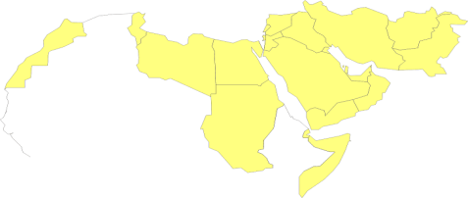
Integrating HTA into
Public Health Policies
Adham R Ismail, MSc, MBA, PhD
Team Leader, Essential Medicines and Technologies Team (EMT)
Regional Adviser, Health Technology and Biomedical Devices (HMD)
Department of Health Systems Development (HSD)
Eastern Mediterranean Regional office (EMRO)
World Health Organization (WHO)
Cairo, 2015

Slide 2
18

Slide 3
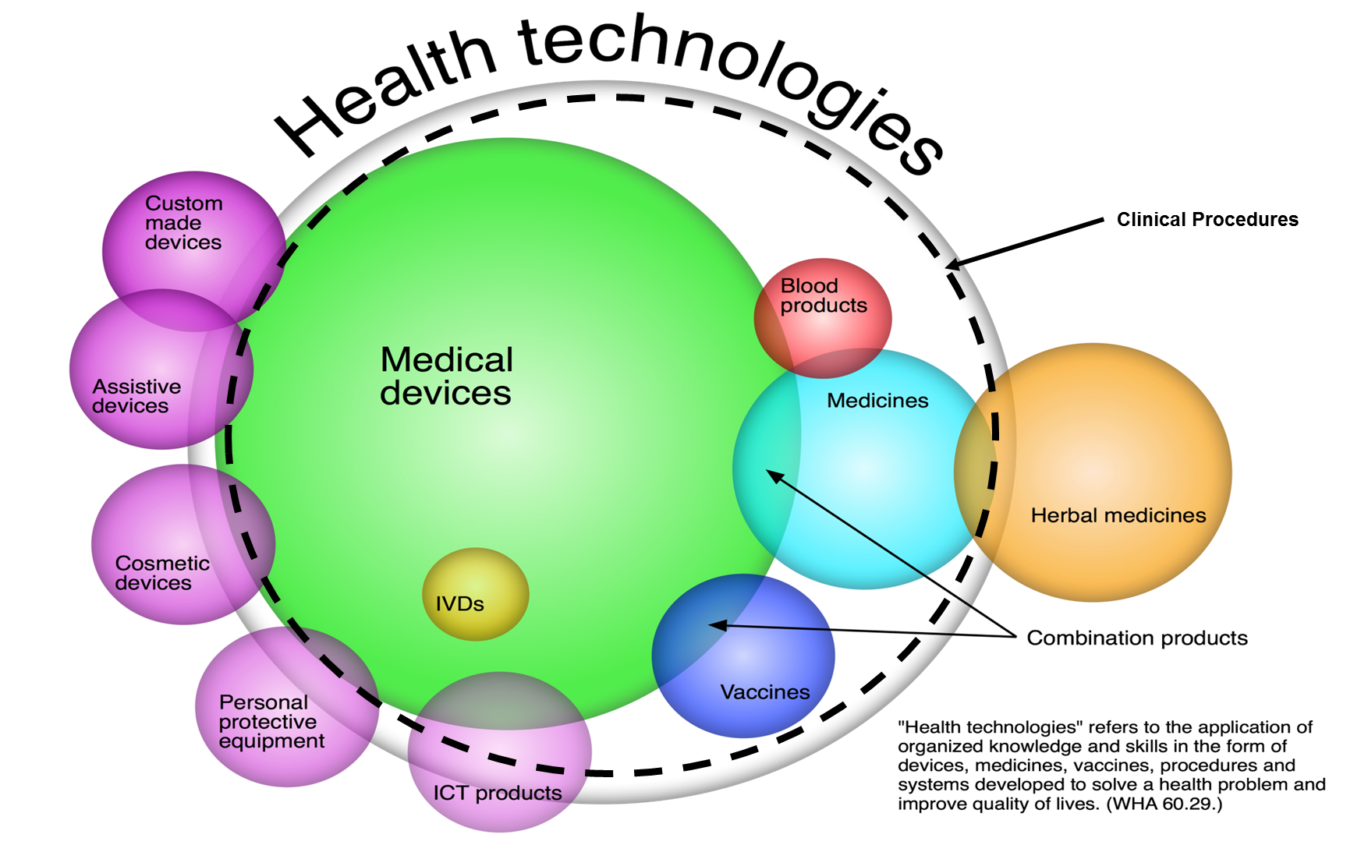

Slide 4
Current Operating Context:
The need to Manage HT
In a supply-driven market, suppliers can be expected to target the region
It will be difficult to contain the burgeoning costs without proper management of demand, through:
  Strengthening NRAs
  Establishment of HTA to support decision making
  Proper HT Management plans (from needs assessment to waste disposal)

Slide 5
HTA Reasoning
How can we use it effectively?
Implementation
Do we really need it?
Appropriateness
Health Technology Assessment
Can it work in my country?
Effectiveness
Efficacy
Is it safe and of good quality?
Safety
Regulation
Notes:
Here=need for context
Issues of decision-making framing HTA: Macro…hospital, closed budget..open budget
Here: Decision-making issues are determining the scope of the assessment
Multiple types of evidence
Stakeholder involvement in assessment process
Clinical Effectiveness
The extent to which a specific intervention, procedure, regimen, or service does what it is intended to do under ordinary circumstances, rather than controlled conditions. (INAHTA Glossary)
Clinical Performance
The ability of a medical device to achieve its intended use as claimed by the manufacturer (GHTF/SC(PD3)/N4:2007)

Slide 6

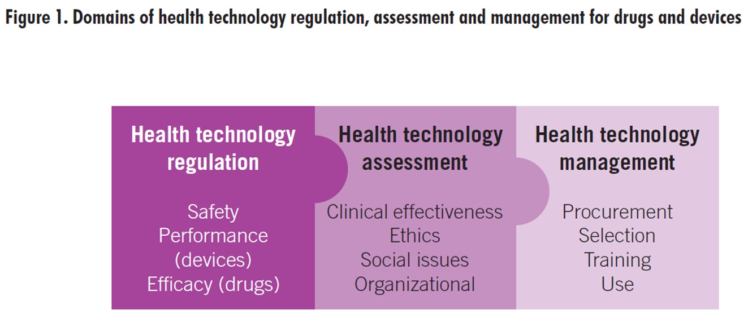
HT Policies
Health technology
Innovation
Medical Processes (R&D)
Business Processes (Marketing, Financing, IT &/or Operating)
Valley of Death

Slide 7
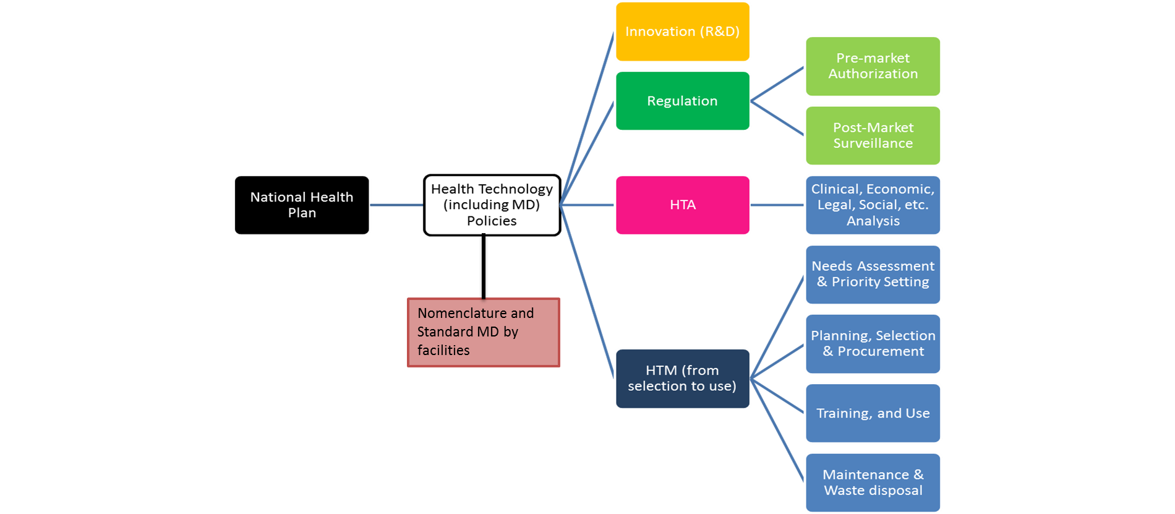
From National Plan to HT Policy

Slide 8
From HT policies…. to Health outcomes
HT Policies
Innovation
R & D by Industry and Academia
Regulation by National authorities
HT Outcomes
Quality,
Safe and Effective
Affordable
Assessment by National or local committees
Management by National, or local units.: selection , procurement, installation and maintenance.
Appropriate
Available
Accessible
Acceptable
PH Outcomes
Quality of life
Life saving
Independence
Economic development
Attainment of highest level of health (WHO)

Slide 9
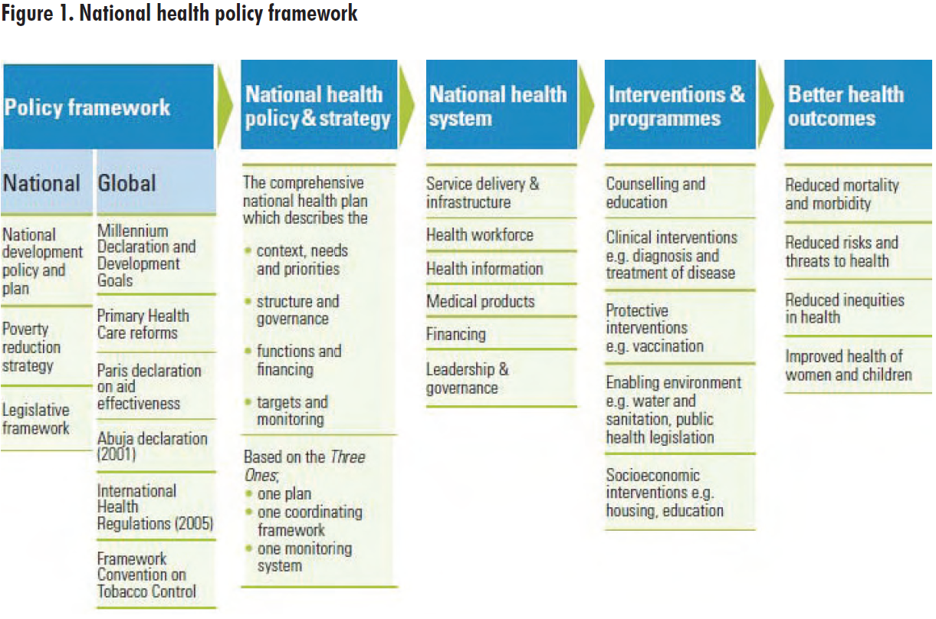
MD National Policies and Plans

Slide 10
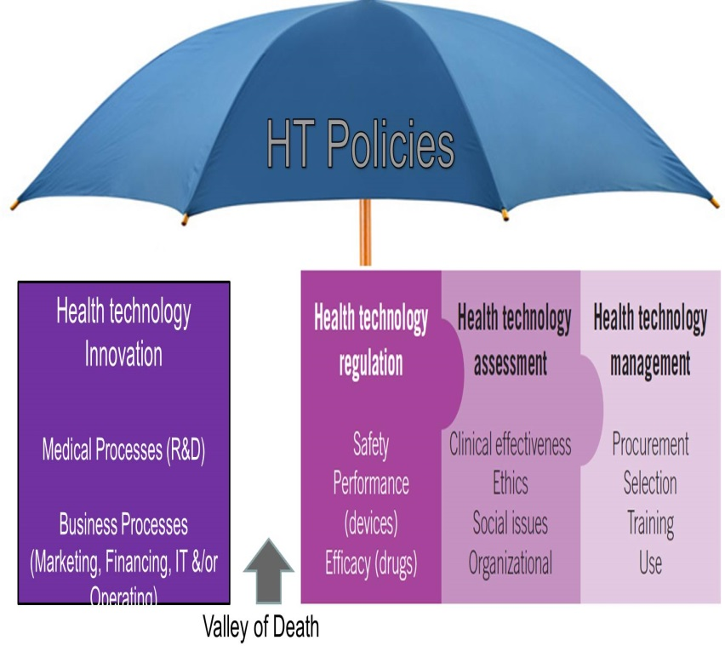
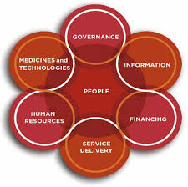

Integrating HTA into Public Health Practice
HTA Institution
To improve Access
To achieve UHC
Prioritize PH needs
Identify relationships with other HS building blocks
Develop major areas of work
Prepare human & financial resources (also QA programmes)
Develop an organizational structure
Identify TORs for different processes
Develop core set of indicators
To improve HS
5 HT Components
6 HS Building Blocks
SDG 3.8

Slide 11
Integration Steps:
1. Formulate HTA team & its roles
  The role of HTA in PH is prominent when there is:
    An increased pressure on public funding
    Scarcity of heath resources
    Release of new HT in markets.
  HTA teams composing of different backgrounds (clinicians, PH specialists, pharmacists, biomedical engineers, statisticians, etc.) should be formed to answer these PH needs.
  Roles and responsibilities include:
    Active engagement of all key stakeholders groups.
    Revision of evidence related to selected technologies.
    Conduction of assessment studies and surveys (if needed).
    Consultations with external experts (if needed)
    Communication of findings appropriately to decision makers

Slide 12
Integration Steps:
2. Establish HTA-based committees
HTA-based committees are established to apply the framework and prioritize HT. They are responsible for:
  Actual implementation of the HTA process using available evidence, literature reviews, surveys, expert consultations, peer reviews, etc.
  Appraisal and Dissemination of results to policy and decision makers
The committee is composed of representatives from
  Ministry of Health and other Governmental entities
  National Social Insurance or other financial entities
  Universities and other educational institutions
  Patient associations and NGOs.
  Other stakeholders

Slide 13
Integration Steps:
3. Define HTA activities suitable for each HS
Countries with low coverage:
Primary health care packages
Strong health systems:
Marginal analysis for additions to packages
Countries with medium coverage:
Guaranteed packages of care
Fragile states:
Essential services
Emergency kits
Disaster planning
Health Systems
Continuum of HTA Activities
Notes:
Health technology assessment (HITA) provides a decision-making framework for different types of decisions and can be applied in all health care systems, but needs differ
In fragile health systems: to identify essential guaranteed services
In middle-income countries with limited coverage: to decide how to extend the package of health care services provided
In systems with established UHC: to inform decisions ‘at the margin’: what extra services to provide and at what cost

Slide 14
Integration Steps:
4. Define scope of HTA services
Fragile states:
HTA define:
Basic packages
Emergency kits
Disaster planning
Countries with low coverage:
HTA define PHC interventions:
Essential medicines package,
Essential Kits and interventions
Vaccination package
Prevention and some treatment.
Define which ones to add. and to whom.
Middle and high income countries with medium coverage:
1. HTA define :
Package of interventions on prevention, promotion, and some on treatment and rehabilitation.
2. HTA also define extensions on :
NCD interventions
Vertical programs.
For specific populations.
Strong health system:
1. HTA for integrated care & UHC:
- Service coverage:
Prevention, Diagnostic, Treatment, Rehabilitation, Palliative care, Home care Medicines, Devices, interventions
- Population Coverage: Children, Adolescents Mothers and Ageing population
2. HTA to define innovative or extra services.
Health Systems
Coverage and resources, define continuum of HTA activities.

Slide 15
Integration Steps:
5. Develop a system to link HTA to policy development
A value-based framework
A HT portfolio
Decision making mechanism
A HT Policy Profile

Slide 16
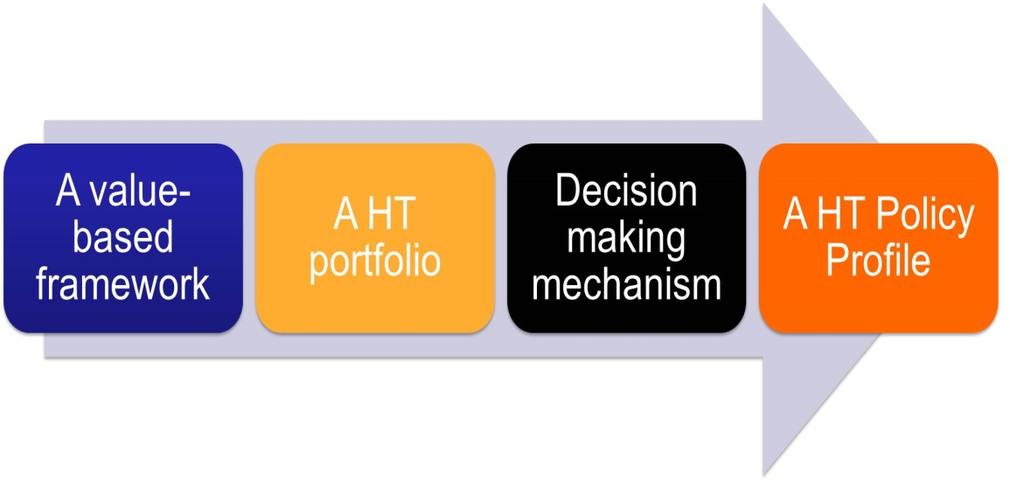
Integration Steps:
6. The Value-Based Framework
A value-based priority-setting framework (not a simple cost per QALY) is used to ensure full benefits.
Multiple-Criteria Decision Analysis (MCDA) techniques are used for selection of appropriate HT based on:
  Severity and burden of disease
  Impact on public health and vulnerable populations
  Urgency of condition and ease of implementation
  Economic and Budget impact analysis
  Equity / equal opportunity
  5 A’s (Appropriateness/Accessibility/Affordability/Accountability/Availability)

Slide 17

Integration Steps:
7a. The HT portfolio
The portfolio should include information on:
  Technology: Effectiveness, validity of evidence, safety & cost.
  Health problem: Severity of disease & cost of illness.
  Beneficiaries: Size, poverty and social status & geographical distribution.
  Market: Brand quality, importer/AR/Distributor quality, & potential for misuse
  Health System: PH priority & Availability of required resources
  Budget

Slide 18
Integration Steps:
7b. Example of a HT portfolio
general description of technology
name of technology
Type of technology | drug | surgery | diagnostic | nutritional | Complementary
 | implant | procedure | biotechnology | nanotechnology | Information technology
level of technology | low |  | medium |  | high
life cycle of technology | entrance | development | steady state |  | decline
Intellectual Property of Technology | active |  | near expiration |  | Expired
Importance of technology
Frequency of use | Very low | low | medium | high | very high
Importance of Health problem | Very low | low | medium | high | very high
Efficiency in Investigational environment | Very low | low | medium | high | very high
Evidence | Very low | low | medium | high | very high
Effectiveness | Very low | low | medium | high | very high
Safety | Very low | low | medium | high | very high
Strategic Importance | Very low | low | medium | high | very high
restriction | Very low | low | medium | high | very high

Slide 19
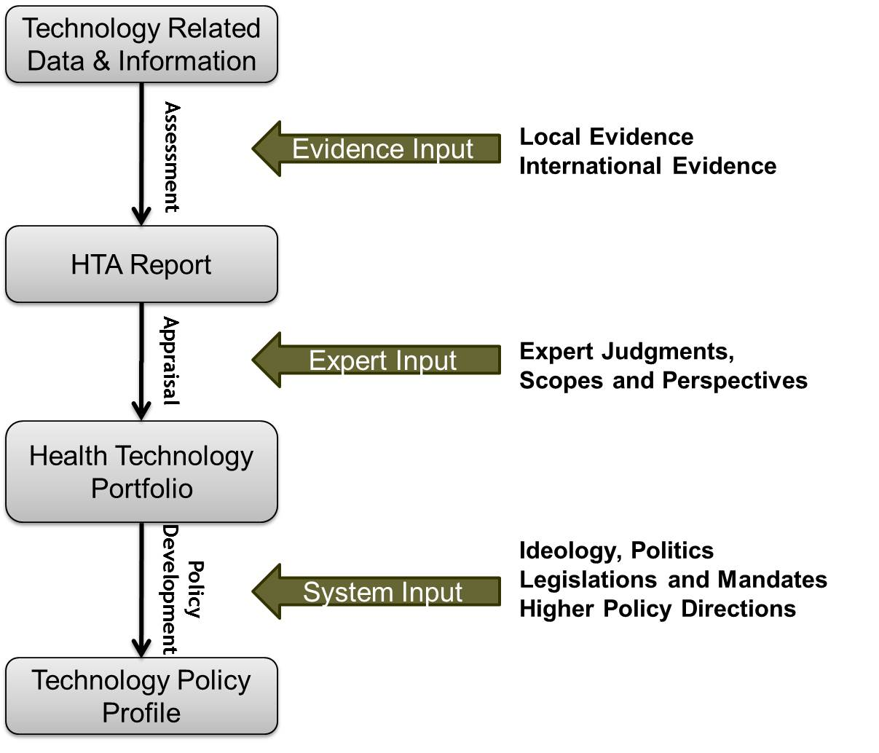
Integration Steps:
8a. The decision making mechanism

Slide 20
Integration Steps:
8b. Example of a decision-making system sheet
Code | HTA related policies appropriateness rating Technology
1-1-1 | This Technology is authorized for investigational purposes | 0 10 20 30 40 50 60 70 80 90 100
1-2-1 | This Technology is not authorized for entering healthcare market | 0 10 20 30 40 50 60 70 80 90 100
1-2-2 | This Technology is authorized for entering healthcare market | 0 10 20 30 40 50 60 70 80 90 100
1-2-3 | This Technology is authorized for entering healthcare market in condition of providing necessary human resource | 0 10 20 30 40 50 60 70 80 90 100
1-2-4 | This Technology is authorized for entering healthcare market in condition of setting up supervision system | 0 10 20 30 40 50 60 70 80 90 100
1-3-1 | This Technology is authorized for Importation | 0 10 20 30 40 50 60 70 80 90 100

Slide 21
(HTAs of 12 new technologies made by different HTA agencies in 2009)
Integration Steps:
9. Typical decisions and their variance across countries

Slide 22
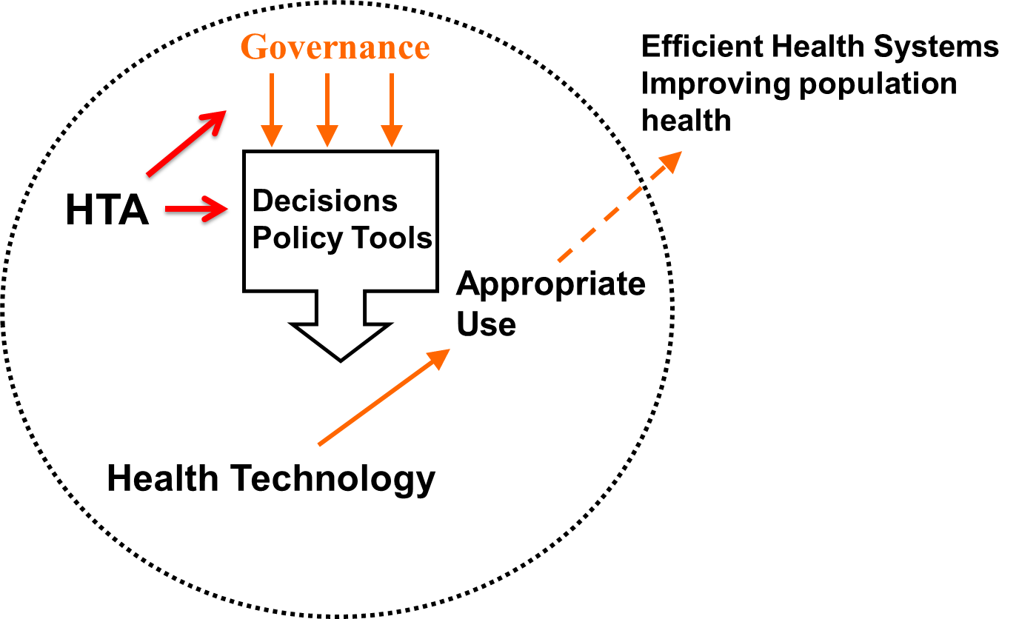
Integration Steps:
10. The HT policy profiles and impact on PH governance
Influence of HTA on PH governance can be measured at 2 main levels:
  Policy Implementation Level
    CPG
    Design of basic packages
    Service Delivery
    Reform or provider payment systems, including HI schemes
  Individual HT Level
    Registration
    Reimbursement

Slide 23



