Slide 1

Challenges of HTA
Implementation: the Case of Egypt
Gihan Elsisi, MSc, PhD
Managing Director, HTA Office L.L.C
Principal, Pharmacoeconomics Committee, MoH
Founder & Former Head of Pharmacoeconomic Unit, MoH
Lecturer, Faculty of Economics and Political Science, Cairo University
Lecturer of Economic Modeling & Costing, Arab Academy for Science and Technology
Lecturer, Faculty of Pharmacy, Heliopolis University
Treasurer of ISPOR Egypt Chapter

Slide 2
Egyptian Pharmacoeconomic Unit
Vision
Provide scientific guidance of the value of drugs in delivering expected outcomes to decision makers, health professionals and the public.
Mission
Evaluate economic studies of both new and existing pharmaceutical products and medical devices.
Conduct economic studies for products selected in Tender List, Essential Medicine List and Hospital Formulary.
Provide education and training programs to build capacities.

Slide 3
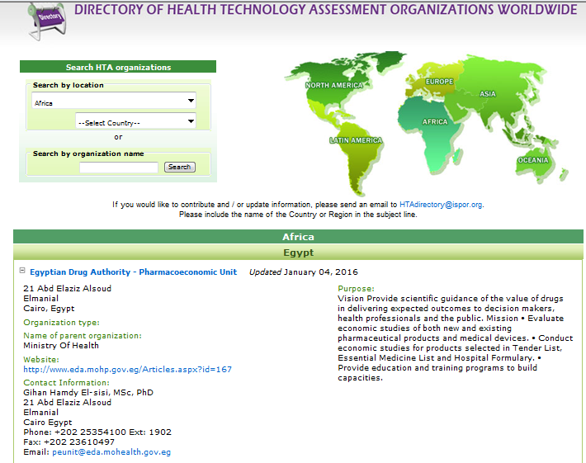

Slide 4
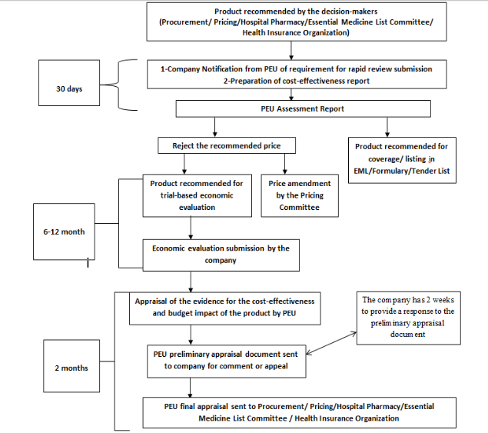

Slide 5
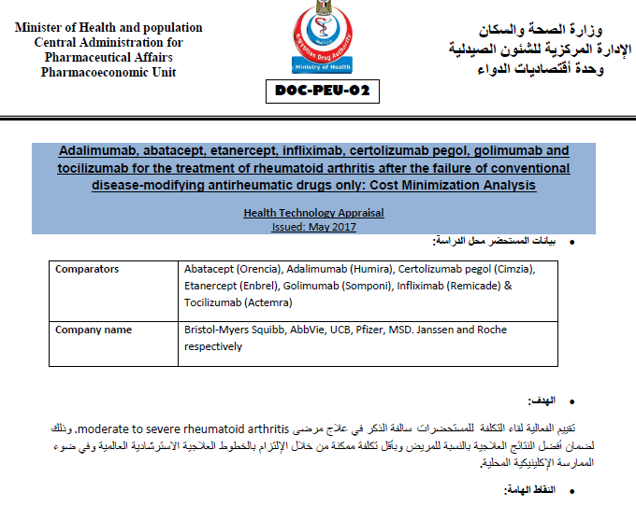

Slide 6
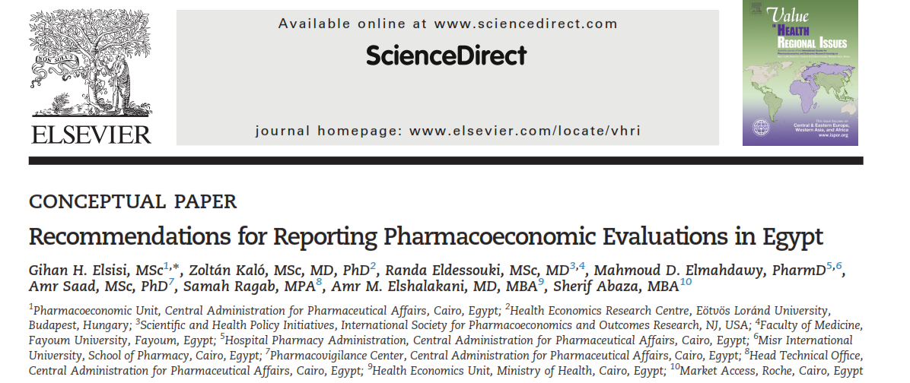
Egyptian Guidelines

Slide 7
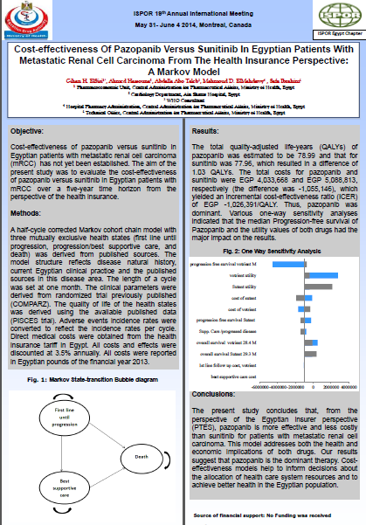
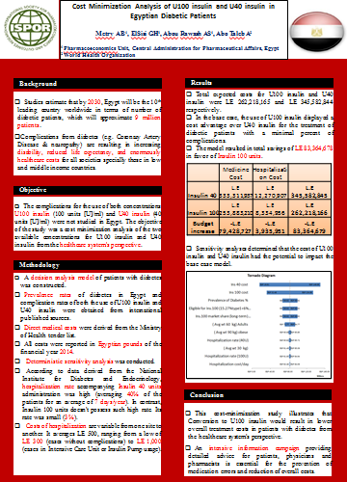

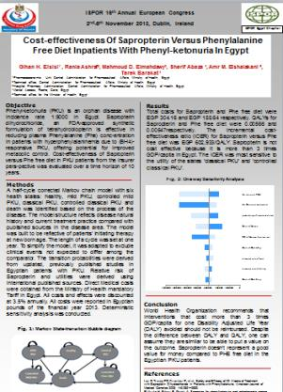
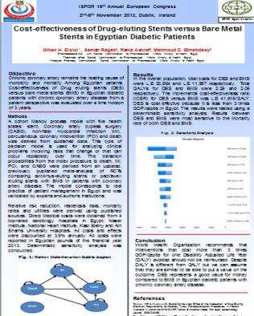
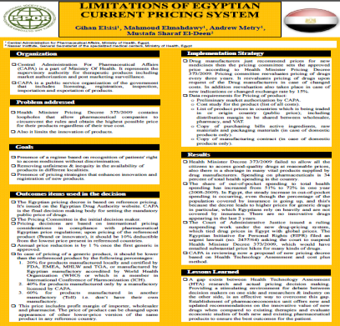

Slide 8


Slide 9


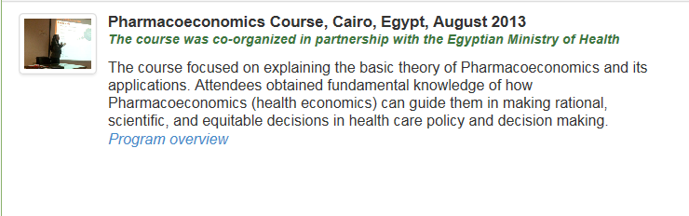
Educational Activities

Slide 10
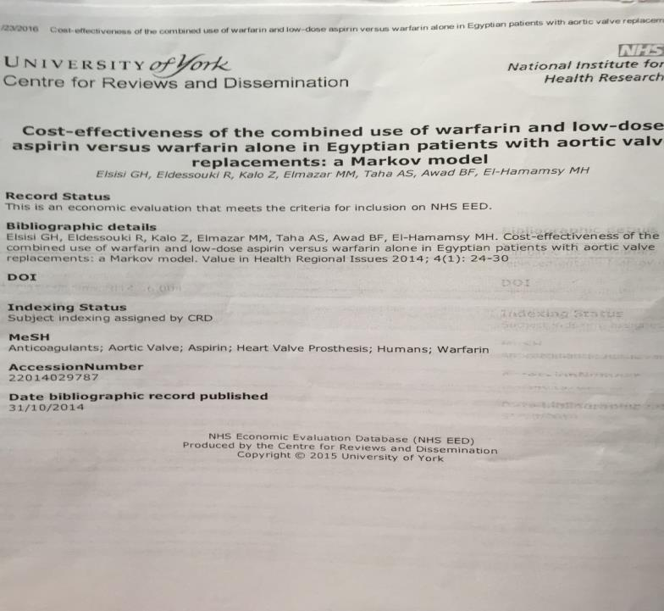

Slide 13
Challenges in HTA implementation
No mandatory HTA legislations that fosters the implementation of cost-effectiveness studies.
No localized clinical data to improve the validity and the implementation of cost-effectiveness studies.
Lack of building capacities to improve the studies excellence to assure competent evaluations
Less funding for the pharmacoeconomic unit to access international databases and cooperate with reputable firms specialized in this discipline.

Slide 14
Challenges in HTA implementation
No clear vision and strategies towards health care synchronization.
No health care information system with the aim of creating an epidemiology profile for Egypt along with detailed local clinical data.
Notes:
All those challenges could be solved under the road map of UHC that Egypt committed to be achieved by 2030.

Slide 15
The current plan
Raising awareness campaigns to the high level decision makers.
Training programs to all the public and private hospitals.
conducting more health economic studies to allocate our resources.
Working with the health insurance organization (HIO) to build the HTA department.

Slide 16
Thank you so much for paying attention
For any queries, Please contact:
Gihan Elsisi
Gihan.elsisi@htaoffice.com
01227366018

