Slide 1
HEOR & CURRENT IMPLEMENTATION CHALLENGES IN THE UAE
Second Regional Health Technology Assessment Policy Forum
A Step Forward: Moving from the ‘What?’ to the ‘How?’
Ola Ghaleb Al Ahdab, PhD.
Pharmaceutical Advisor, Drug Department, MOHAP, UAE www.mohap.gov.ae
Adjunct Assistant Professor, Colleges of Pharmacy, UAE
President, ISPOR United Arab Emirates Chapter
President Elect , ISPOR Arab Network www.ispor.org
Vice-President FIP Social & Administrative Pharmacy Section www.fip.org
Vice-President for Pharmacy Society, EMA www.ema.ae
17-18 September 2018

Slide 2
Your presentation should address challenges and problems related to governance, finances of medicines , technology and innovations given the experience of UAE.
9:30-11:15 Session 4: Integration of HTA into Public Policy
Chairperson:
Hossam Abd El Ghafaar, Supreme Council, University Hospitals, Egypt
Speakers:
Adham Ismail, WHO/EMRO
Hector Castor-Jaramillo, Pharmaceutical Economics & Financing, NSH
Ola Al Ahdab, MOHP,UAE
Open discussion

Slide 3
AGENDA
                INTRODUCTION
                THE UAE: KEY INFORMATION
                CURRENT CHALLENGES
                SUMMARY

Slide 4
INTRODUCTION : MENA Region
Pricing medication is controlled by government
Public Pharmaceutical market via tendering
More than 140 pharmaceutical factories operating across the region
Local production dominated by Generic Manufacturers
Strong dependence on imported finished products
Strong dependence on imported raw materials
There are slow down in the GDP growth as a result of low oil prices

Slide 5
UAE: Key Information
Population: 9.12 million population (Dec 2016)
Total GDP $bn 379 )2016 : 2nd in GCC (<KSA ) 3rd in MENA region
Total life expectancy at birth = 76.9 years
Industry is fuelled with latest technology
International service providers manage many facilities in the UAE with high standards
MOHAP has mandated all facilities to achieve International accreditation by 2021.
Health Insurance models becoming the dominant way of health funding.

Slide 6
The Health Care System In The UAE
Regulators
Healthcare Providers
Payers'
Suppliers+

Slide 7
UAE 7th most competitive in the world
Jump from Position 10 to Position 7 in 2018
https://www.imd.org/wcc/world-competitiveness-center-rankings/world-competitiveness-ranking-2018

Slide 8
Pharma-Regulatory Culture
The Intellectual Property Protection in the UAE considered strong (UAE is WTO member and signatory to TRIPS)
≈ 85% of pharmaceuticals are imported
MOHAP regulates Conventional & Complementary Medicines ; Medical Devices and Veterinary Medicines
MOHAP regulate Drug Price
PV/ Risk management plan for each registered medicine mandatory within registration process
GCC Price Dollarization and CIF Unification rational and promote patient access to innovative drugs in the GCC.
Quality healthcare services, Quality Education and capacity building are at the top of the UAE government agenda & 2021 Vision.
Fast Track: Accelerated Approval and Availability of life saving and innovative drugs in the UAE.
*MOHAP (Ministry of Health and Prevention)

Slide 9
Fast Track Approval: Promoting Early Patients Access to Innovative Medicines
Therapeutic Areas
For Fast Track Approval
20 fast track approvals
Notes:
20 innovative medicines received fast track review have contributed to the enhancement of the quality of care of patients in the country

Slide 10
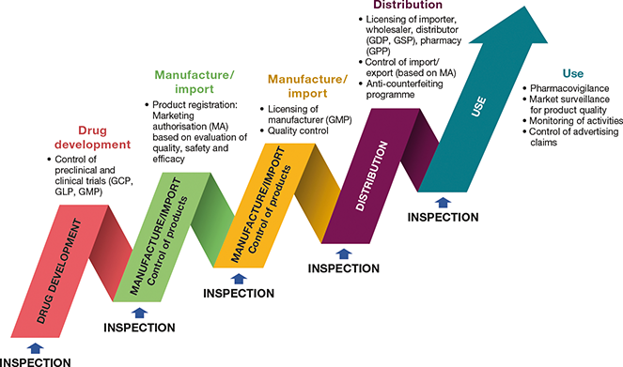
Pharmaceutical Regulatory in the UAE

Slide 11
Pharmaceutical Market Expenditure By Sub Sector (2017= 2.841 USDbn)
1-Rx Patent 67%
2-Rx Generics 19%
3-OTC 14%
BMI Report Q4/2018

Slide 12
Pharmaceutical Sales Data in the UAE in USDbn ( Historical & Forecast)
BMI Report Q4/2018

Slide 13
Pharmaceutical Sale % of
Health Expenditure
BMI Report Q4/2018

Slide 14
Are We Ready: For Using Economic Evaluation Formally?
Cost Effective Analysis (CEA); Budget Impact Analysis (BIA); HTA; Value Based Pricing & Pay for Performance/Managed Entry Agreement (MEAs) are an example for decision making tools that promote rational access to innovated medicines and facilitate the rational reimbursement decision
However, Middle East countries & the UAE are relatively underdeveloped in applying PE/HE & HTA for formulary inclusion and reimbursement decisions
Barriers to the use of economic evaluation are existing

Slide 15
The Situation In The UAE
HCPs from around the world & mix education background
High potential for irrational use & wastage of HC resources
Lack of updated Standard Treatment Guidelines for many diseases
Lack of appropriate on service training and education
Gaps in academic syllabus and the practice needs
Lack of valid willing's to pay per QALY
Lack of active communications between partners & Stakeholders
Relatively new health insurance & reimbursement system
Lack of related regulations and mandates
Lack of healthcare data base
Lack of related drug use study and outcomes research
Lack of HE, PE & HTA infrastructure
Lack of experts in HE, PE and Health Technology Assessment

Slide 16

Barriers to the Use of Economic Evaluation in Policy Decision-Making: Example From Asia
Using Economic Evaluation in Policy Decision-Making in Asian Countries: Mission Impossible or Mission Probable? (ISPOR) 1098-3015/09/S26
Production of Economic Information
  Setting related: Population, Socioeconomic & Provider
  Poor quality of evidence / bias of studies
  Delay the adoption of economic evolution in policy decision-making
  Decision Makers preference locally relevant information.
  Prioritization: no economic evaluation for major health problems
  Economic Evaluation Guidelines
Decision Context-Related Barriers
  Lack of understanding of economic evaluation
  Politics : the power
  Ethical considerations: the culture
  Standardization of Economic Evaluation Methods
Key Proposed Solutions
  Making Economic Evaluation Available
  Prioritization of topics for assessment
  Educating Decision-Makers, HCPs & the Public
  Making the Economic Evaluation Processes Transparent and Participatory

Slide 17
What We Need ?
Active communication/collaboration
Appropriate education for decision makers, healthcare professionals and the public
HE, PE & HTA infrastructure:
  Independent HTA Agency
  Related regulations and mandates
  Pharmaceutical/ HCS Database
  Implemented PE/HE Guideline
  Valid willing to pay value per QALY/LYG
  Related studies & outcomes research
  Dynamic Clinical Guideline(s)
  Education and training for decision makers, healthcare professionals and the public
  Develop UAE patients advocate

Slide 18
Recommendations
The need to use PE/HE/&HTA methods formally are excising
High level governmental support is an essential requirement to facilitate the PE/HE& HTA implementation in long term plan
Regulators, academia & ISPOR regional Chapter has a key role in:
  Provide appropriate training & education to HCPs and Public
  Changing the culture& overcome challenges
  Include the PE/HE in all medical related colleges curriculums
  Develop and update related policies
  Developing PE/HE & HTA infrastructure
  Implementing related good practices
Joint efforts among all partners, stakeholders along with media support are the key driver to facilitate the implementation of HEOR & HTA.
4 slides

Slide 19
Summary
PE/HE& HTA are needed and the future’s decision making tools for formulary and re-imbursement process in the UAE and in the region.
Joint efforts & collaboration among partners & stakeholders are the key driver to have sustainable health care system and in developing & implementing the HE, PE & HTA in the UAE&MENA
Barriers to the use of economic evaluation are exciting.
Regulators, academia & ISPOR regional Chapters have an important role to overcome current challenges, in capacity building, providing appropriate training & education and in developing and implementing HE, PE & HTA in the UAE
High level governmental support is an essential requirement to facilitate the development and implementation of PE/HE&HTA
4 slides

Slide 20

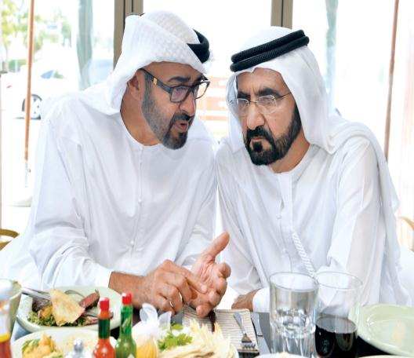
The Way Forward: UAE VISION 2021
“With our Citizens at the heart of development, we strive to become one of the most competitive countries in the world”
His Highness Sheikh Mohammed Bin Rashid
Al Maktoom

Slide 21
Key Resources
Ministry of Economy www.economy.gov.ae
UAE Statistics www.uaestatistics.gov.ae
www.ispor.org
BMI Q4-2018 report
MOHAP Data www.mohap.gov.ae
World Bank Reports www.worldbank.org
The IMD World Competitiveness Centre https://www.imd.org/wcc/world-competitiveness-center-rankings/world-competitiveness-ranking-2018
Jomkwan Yothasamut, Sripen Tantivess, Yot Teerawattananon. Using Economic Evaluation in Policy Decision-Making in Asian Countries: Mission Impossible or Mission Probable? (ISPOR) 1098-3015/09/S26
Güvenç Koçkaya, Albert Wertheimer; Ola Al Ahdab & et al. Pharmaceutical Market Access in Emerging Markets book, (Chapter 6: Market Access in the United Arab Emirates and selected Middle Eastern Countries -Pages 129-162)
Al Ahdab, O. (2008). Role of Pharmacoeconomics in Clinical Pharmacy Service Development. PhD thesis, Queen's University, School of Pharmacy.

Slide 22

22-26 Sep 2019
FIP Congress in ABU Dhabi
SAV THIS DAYS

Slide 23
Thank you
Q&A
Ola Ghaleb Al Ahdab, PhD.
Pharmaceutical Advisor, Drug Department, MOHAP, UAE www.mohap.gov.ae
Adjunct Assistant Professor, Colleges of Pharmacy, UAE
President, ISPOR United Arab Emirates Chapter www.ispor.org
President Elect , ISPOR Arab Network www.ispor.org
Vice-President FIP Social & Administrative Pharmacy Section www.fip.org
Vice-President for Pharmacy Society, EMA www.ema.ae
isporuaechapter@gmail.com
Ola.ghaleb@gmail.com
Dr_ola@moh.gov.ae

