Slide 1


Healthcare PPP Opportunities in the Kingdom of Bahrain
Kingdom of Bahrain
November 2017

Slide 2
Healthcare in Bahrain
Health Service Providers
  28 Government Primary Health Centers
  3 Government Hospitals
  18 Private Hospitals
Hospital Beds
  1,500 Public Sector Beds
  600 Private Sector Beds
Health Sector KPIs
  25.3 Physicians per 10,000 population
  50.1 Nurses per 10,000 population
Health Expenditure
  3.3 % of GDP
  461.4 Total Health Expenditure (BHD m)
  129.7 Private Health Expenditure (BHD m)

Slide 3
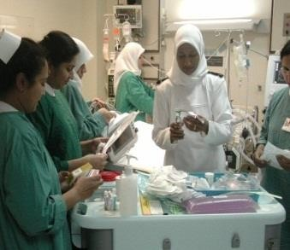

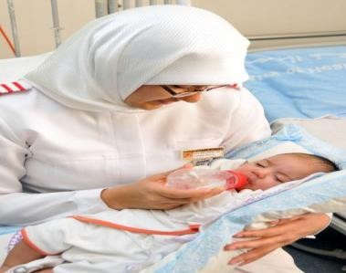
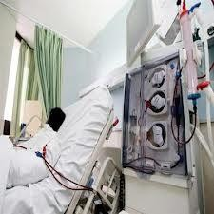
MAJOR CHALLENGES
Demographic changes
Increasing life expectancy
Increase in population
Increase in the geriatric population group
Increase in the prevalence of chronic non-
communicable diseases
Sustainability of financing health services
High cost of care vs Limited financial resources
H O S P I T A L S A U T O N O M Y T E A M
17

Slide 4
Investment and Partnership Opportunities
Competitive advantages
Investment opportunities
  Government support
Enhancing the role of the private health sector is a national priority and the regulatory framework is being revised to facilitate health sector investment
  Specialist health services
Demographic trends
An aging and growing population and lifestyle trends are driving demand for health services
National Diabetics Center
National Dialysis Center
Drug Rehab Facilities
Pediatric Hospital
Neurosurgery Center
Access to regional market
Bahrain’s strategic location enables access to the GCC market
National Cadres
Bahrain has a strong national health workforce in terms of doctors, nurses, and allied health professionals.
  Utilization of surplus capacity in government

Slide 5

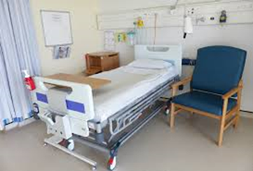

PPP Opportunities at Hospital Level..1/3
Partnership in management of specific areas of healthcare such as hospices for geriatric and palliative care
To provide public health services whenever the capacity of the latter is saturated.
Contract management especially locums or staff involved in job sharing or flexible hours or on demand, etc…

Slide 6



PPP Opportunities at Hospital Level..2/3
Skill development in specific areas, example: financial skills, business development, etc…
Asset management and investment
Social Marketing and re-branding
Home Care Teams
Telemedicine and mobile health

Slide 7


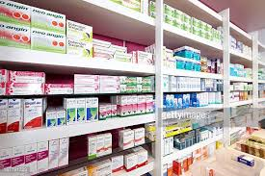

PPP Opportunities at Hospital Level..3/3
Management of leases of major services to the private sector ( Example: MRI services, Central laboratory services, etc..).
Outsourcing of support services
Partnership in pharmaceutical procurement & supply
Operation of private wards
“Front Desk” management

Slide 8


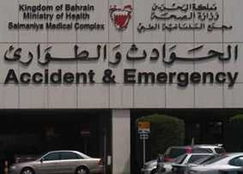

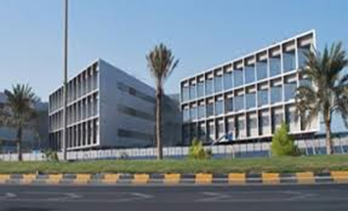
Current Health Sector Structure
Monitoring and Policy Setting
Supreme Council of Health
Ministry of Health
Bahrain Defense Force (BDF)
National Health Regulatory Authority
Financing
Ministry of Finance
Private Health Insurance Companies
Service Delivery
MOH Hospitals and Primary Healthcare Centers
BDF Hospital & Mohamed bin Khalifa Cardiac Center
King Hamad University Hospital
Private Hospitals and Clinics

Slide 9

National Social Health Insurance- SEHATI
The National Social Health Insurance Program is one of the key priorities of the National Health Plan.
Key Elements
Enhance the health system’s structure | Change the funding mechanism | Enhance health services | Change service provider’s operational mechanisms
Separate the service providers from MOH Establish the Health Insurance Fund to collect payments and contract with service providers Establish a center for health information and knowledge «HIKMA», to operate under the SCH | Mandatory financing by the government for Bahrainis and by employers for residents Replace the current funding system with one based on an annual per capita actuarial value | Ensuring access to health services for all based on the basic services package Provide a patient safety net for citizens and residents and reduce the need for direct spending | Enhance the operational autonomy of public service providers Encourage competition among service providers to provide the best quality and most affordable services Boost private sector involvement in healthcare
Review Health Laws

Slide 10

National Health Plan (2016-2025)
Vision
A Healthy Bahraini Society with access to just, competent, and high quality healthcare.
Seven key strategic thrusts
Health Service
Delivery
Methods
Health Service Funding
Capacity Building
Leadership and
Governance
Integrated and Sustainable
Healthcare Methods, Focused on Health
Promotion
Controlling and Directing
Health Service Expenditure and Funding
Recruiting Qualified Staff and Developing Human Resources
Setting Leadership Roles
for Governmental Health Institutions in the
Kingdom
Health Service Quality and
Safety
National Health
Insurance Program
Health Information
Systems
Raising Quality and Safety Standards of Healthcare Services and Ensuring
their Continuity
Sustainable Financial
System that Guarantees Freedom of choosing
health provider
A strong and effective
infrastructure for operating different health
information systems and E-Health
The plan aims to boost support to the Private Sector and Public-Private partnerships, to make the Kingdom a leading regional healthcare destination

Slide 11





Kingdom of Bahrain
Thank You

Slide 12


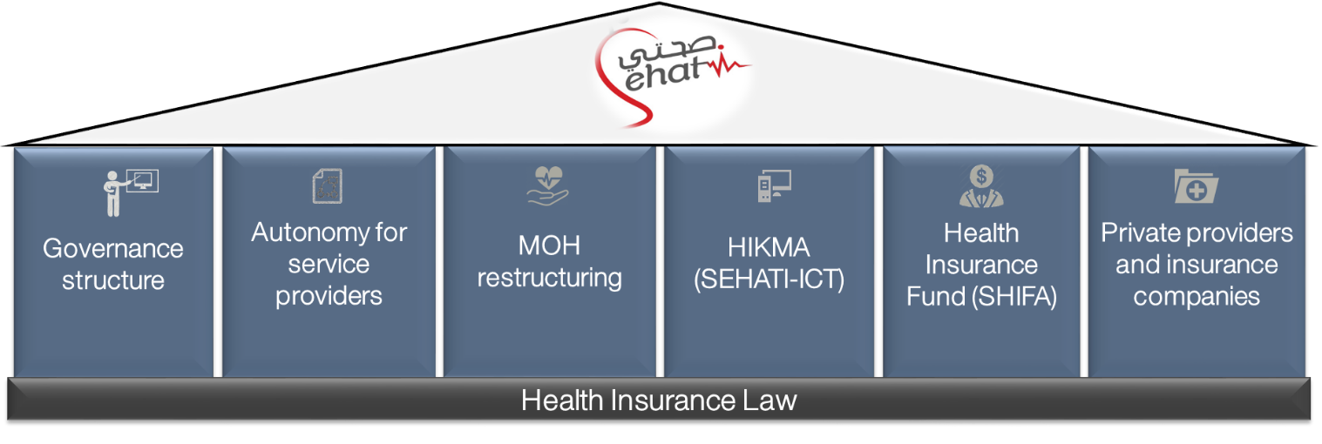
National Social Health Insurance Program (SEHATI): Key Pillars

